Slide 1
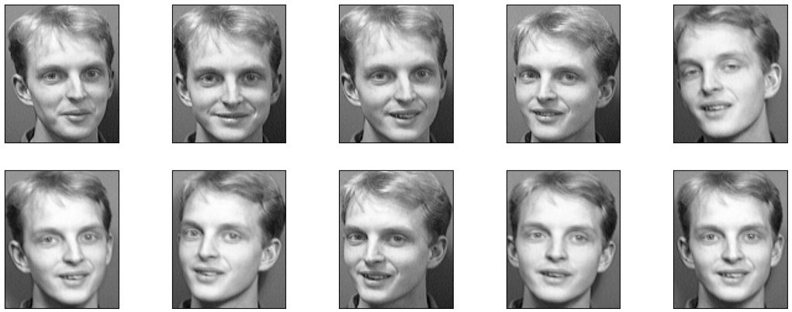
AT&T/Olivetti Facial Recognition with Machine Learning and Deep Learning
Lisa Drain, Dominic Marin, Francisco Latimer, Shoaib Farooqui
Notes:
Francisco: Before we begin, I want you guys to look at these ten pictures of this person. We’ll see if you can recognize them later.

Slide 2
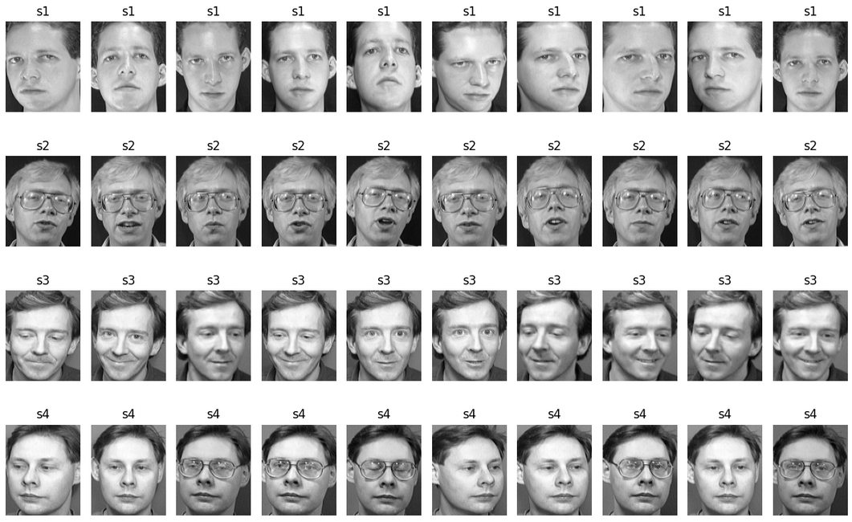
Project Description
Industries: Security, Verification, or VIP Treatment
First step: Identify the best model for our data
Dataset: AT&T Database of Faces dataset (Olivetti Research Laboratory Database of Faces). This dataset consists of 40 individuals each with 10 images.
Goal: Accurately identify the person in an image
Models Used: Random Forest, Logistic Regression, and CNN
Notes:
Francisco: Facial recognition can be useful in practically any industry for security, verification, or VIP treatment purposes. This project's primary objective is to accurately identify the subject in an image from the ATT&T Database of Faces dataset (also known as the ORL Database of Faces). The dataset consists of 40 subjects (individuals) each with 10 images.
This project uses three different models (Random Forest, Logistic Regression, and a Convolutional Neural Network) to assess their suitability, performance, and potential for real-world application. While Random Forest and Logistic Regression employ traditional machine learning algorithms, CNN's deep learning architecture is specifically designed for image-related tasks. By comparing these three models, we hope to gain a better understanding of the capabilities of machine learning and deep learning in the field of facial recognition.

Slide 3
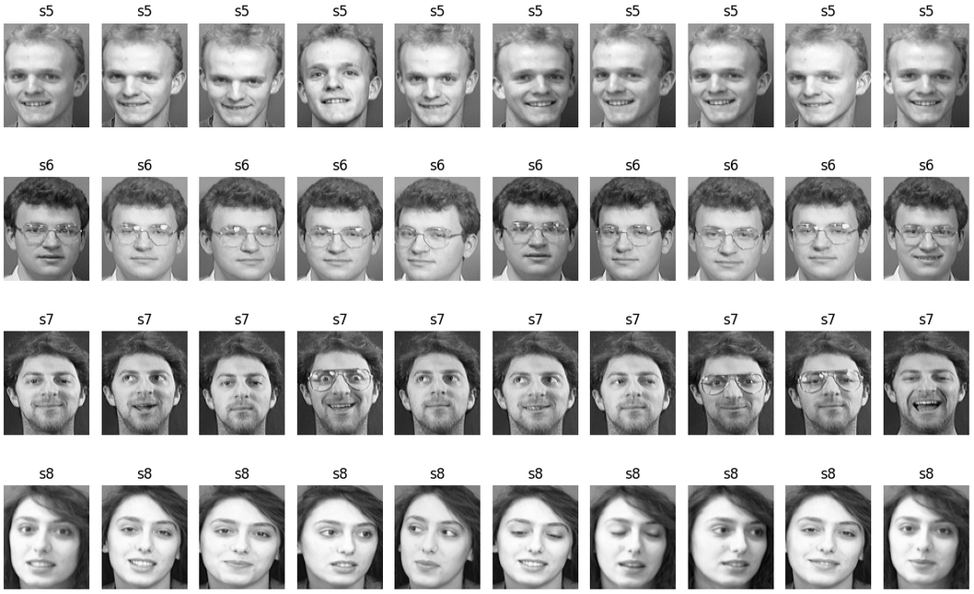
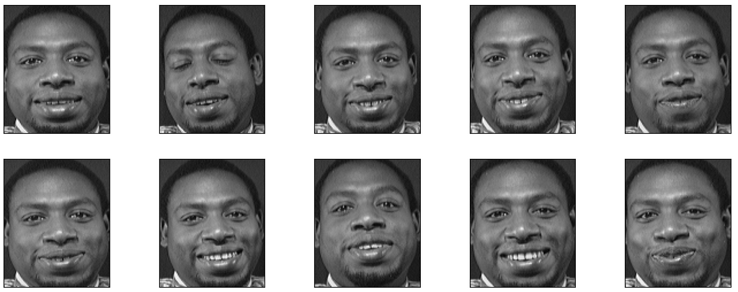
The AT&T Databases of Faces
The Olivetti Research Laboratory (ORL) Database of Faces
Notes:
Francisco: Here are examples of the AT&T dataset. Of the 40 people, 35 are white men, 4 white women, and there is 1 Black man. So, not a lot of diversity. Machine learning models learn patterns from the data they are trained on, and if the dataset primarily consists of a specific demographic, the model may not perform well when encountering individuals from diverse backgrounds. Such systems can perpetuate and amplify existing societal biases and discrimination if they are not adequately trained on diverse datasets. It is crucial to address these biases to ensure fairness and prevent potential harm to individuals from underrepresented groups. Inaccurate or biased results can have serious consequences in various fields, including law enforcement, access control systems, and identification verification. It is crucial to address these issues to avoid misidentification and discrimination. Due to the scope and time constraints of this project, this is not something we were able to address, but it would be an important discussion for further exploration of performance and the implications of the model on this limited dataset.
Now that you have seen the data (along with its limitations) we’re working with, I’ll pass on to Lisa to discuss the machine learning models.

Slide 4
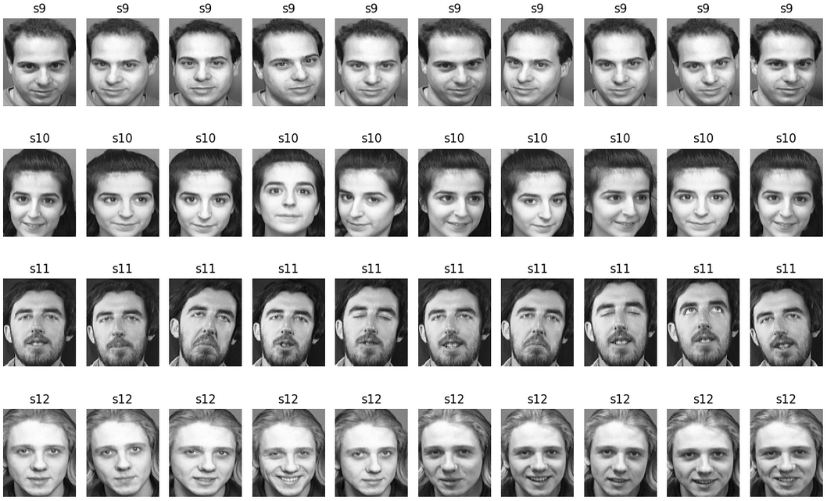
Models
Random Seed: random_state=1
Stratification used for distribution
Testing size of 20%
Trained on 320 images
Tested on 80 images
Notes:
Lisa: For all three models, we used a random seed (or random state) of 1 to ensure reproducibility to provide more valid and consistent comparison of their performance. Stratification was also used across all three to maintain the same distribution of classes in both training and testing sets. And a testing size of 20% was applied across all models as well, enabling fair evaluation of each model's performance.
A testing size of 25% was also tested across all three models, which resulted in lower accuracy across all three models (Random Forest 93.33%, Logistic Regression: 97.50%, and CNN_V9: 92.50%). This was likely due to the more limited training data.

Slide 5
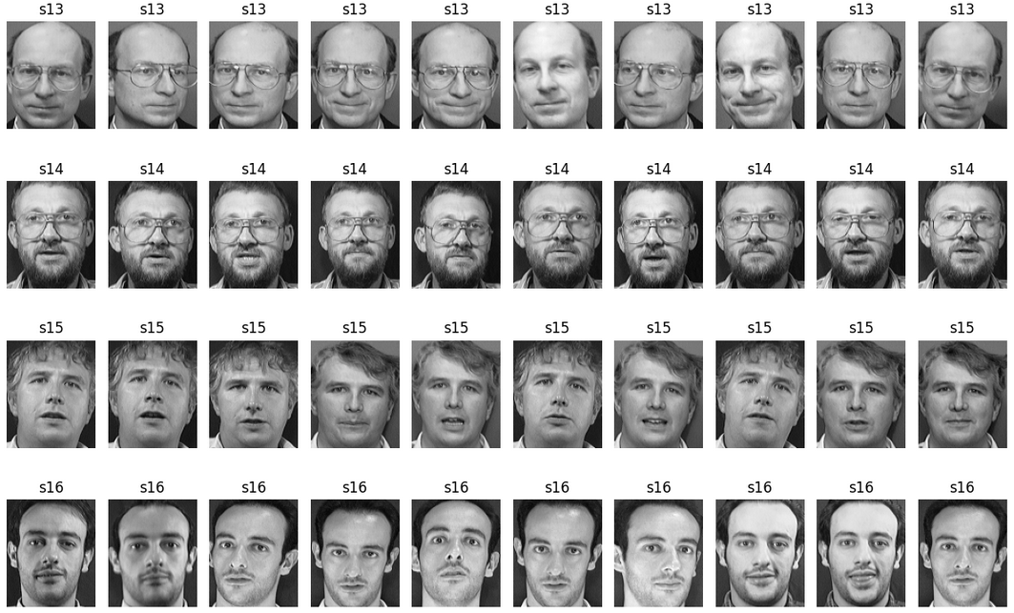
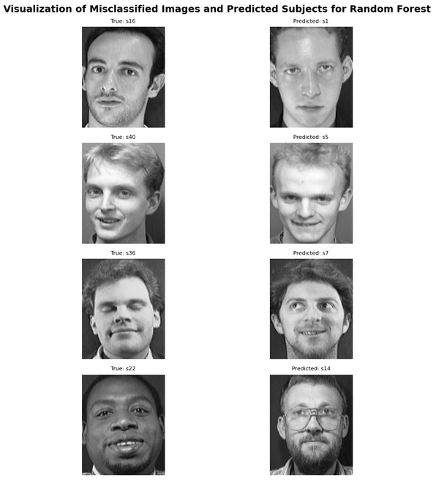
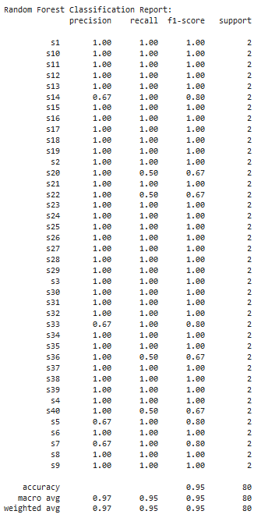
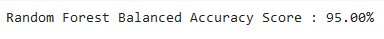
Random Forest Results
Notes:
Lisa: This was the simplest model to set up and saw high accuracy out of the gate. Random Forest demonstrates high precision, recall, and F1-scores for most classes (40 individuals), indicating its ability to correctly classify images of different individuals. The weighted average values show that the model's performance is consistent across all classes, considering the support values (2 images for each individual). The overall accuracy of 95% indicates the model's strong classification capability on our dataset.

Slide 6
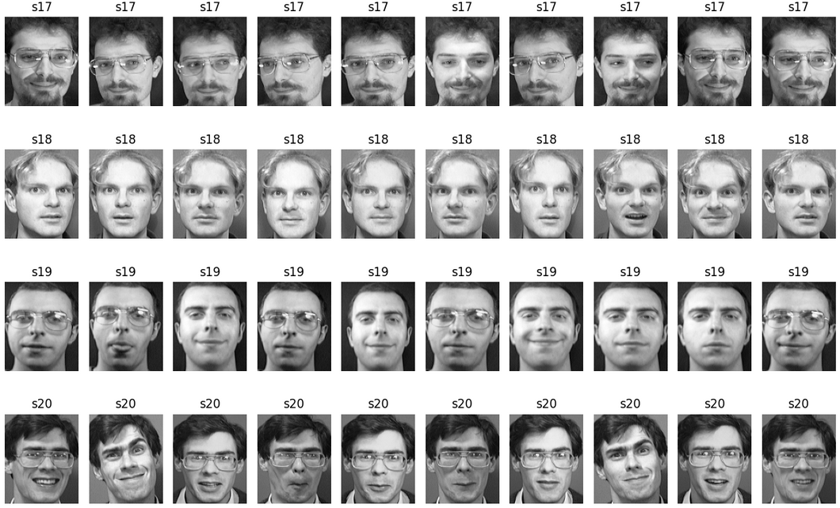
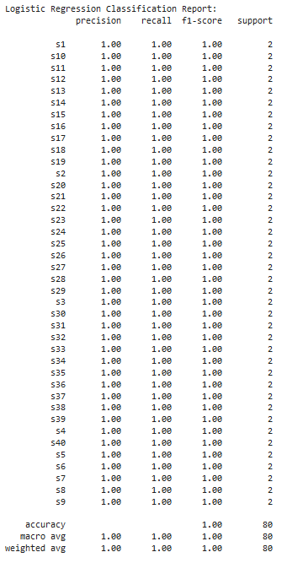
Logistic Regression Results
Notes:
Lisa: With Logistic Regression, the data was first scaled using `<'MinMaxScaler'>` and uses a `<'max_iter>` size of 2500, which iterates through until convergence (where the algorithm has reached a stable solution or the optimal values for the model's parameters). The Logistic Regression model has 100% accuracy, sensitivity, and specificity in correctly identifying individuals from their images, making it highly reliable for facial recognition tasks in this dataset. While this model was a little more complex to set up than Random Forest, it didn’t take much to reach peak accuracy. I’ll pass things off to Shoaib to discuss the final and most complex model.

Slide 7
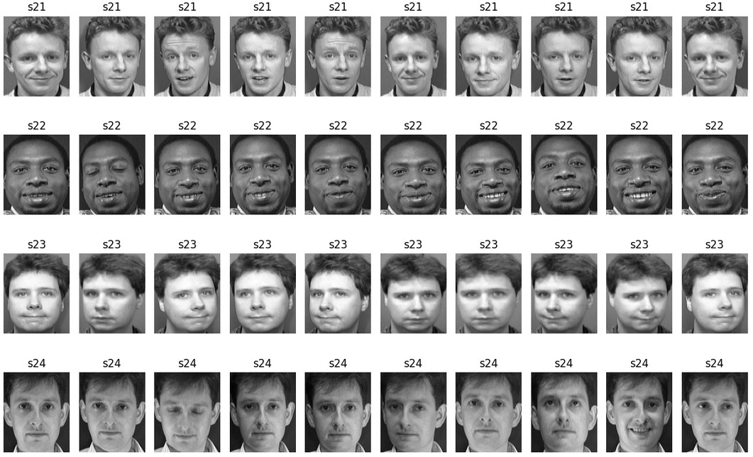
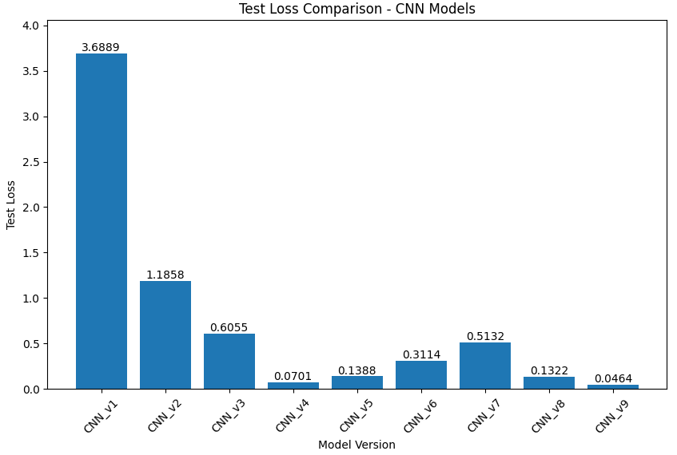
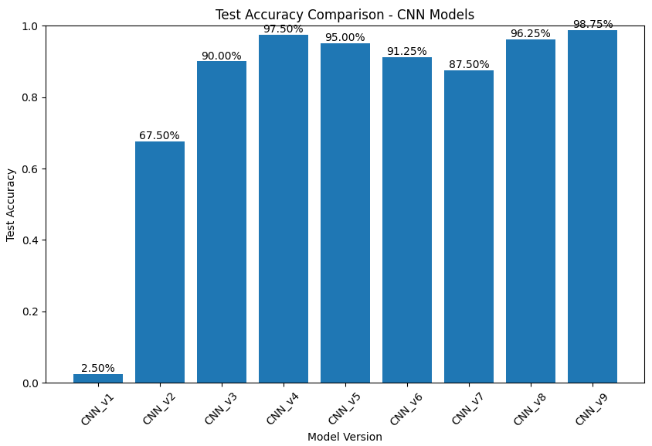
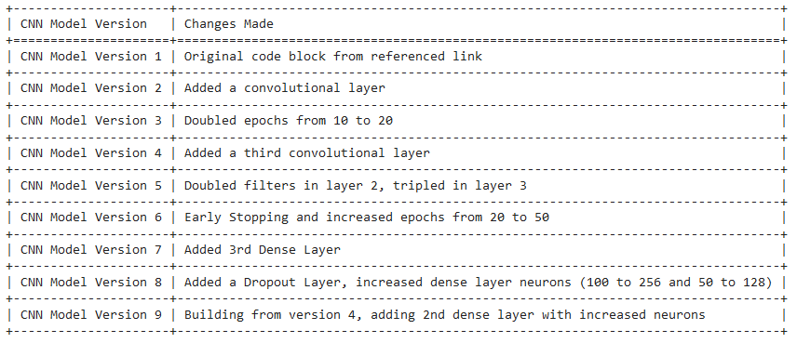
Convolutional Neural Network Models
Notes:
Shoaib: For CNN, the images were reshaped and normalized, and the labels were one-hot encoded. The CNN model was compiled using the keras library and fit to the training data. Through an optimization process, each model version is saved individually to show iterative changes made to the model and the performance. You can see from the top bar graphs how each of the 9 versions performed and in the bottom panel you can see the changes made to each version. What you won’t see are all the other versions where different activation functions (e.g., Leaky ReLU), alternative weight initialization techniques (e.g., Lecun and Xavier/Glorot), the inclusion of batch normalization, and attempts at data augmentation. Due to the computational expense and to ensure clarity and conciseness, these additional attempts were incorporated into the final implementation, though they were part of the optimization process and contributed to the model’s final configuration.

Slide 8
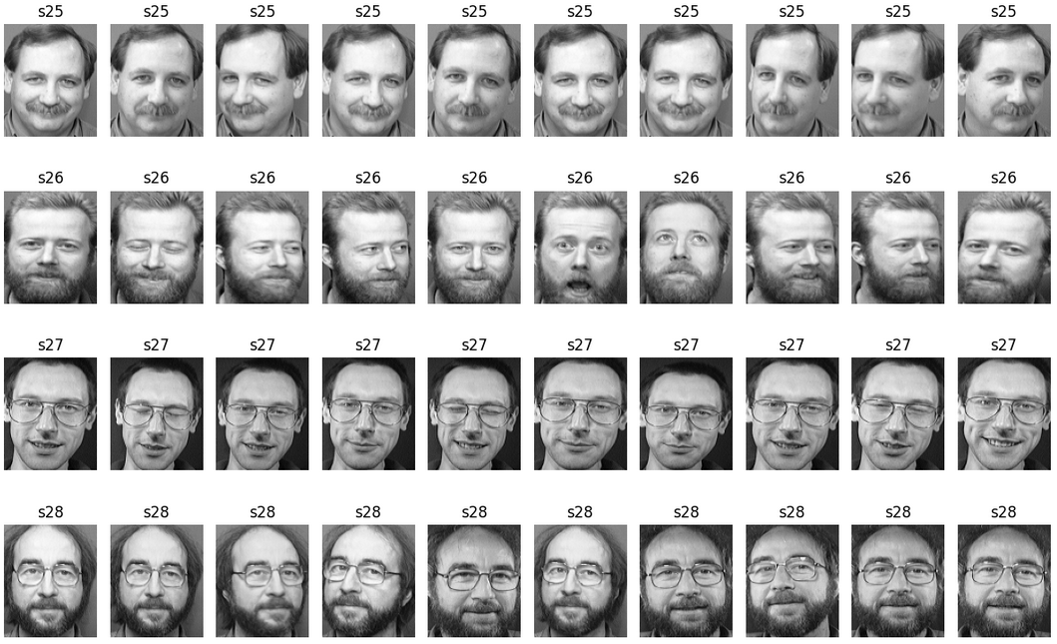
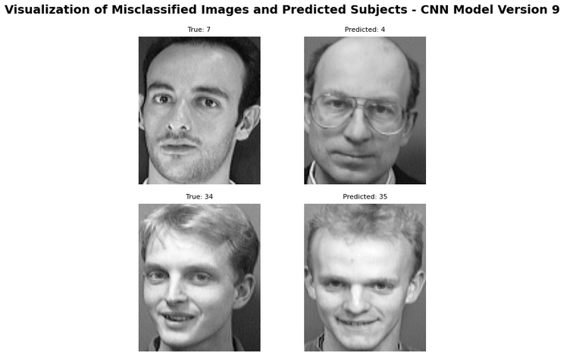
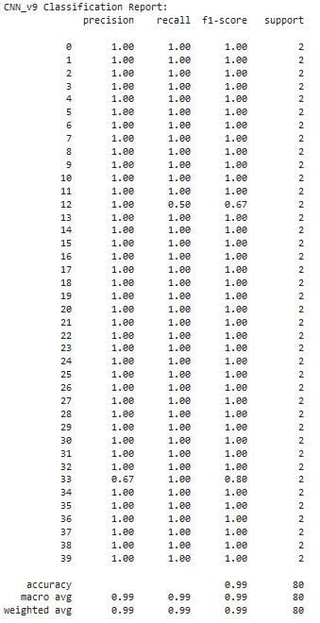
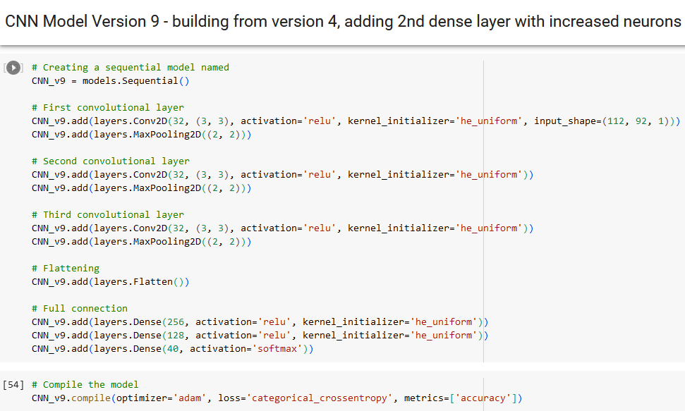
CNN Model Version 9 Results
Notes:
Shoaib: After learning from previous versions, version 9 was formed using three convolutional layers, two dense layers using the relu activation and he_uniform kernel initializer with 256 in the first and 128 neurons in the second, and a third dense layer with 40 neurons using the softmax activation. In terms of performance, the CNN Version 9 model demonstrates a high performance with a balanced accuracy of 98.75% (misclassifying 2 images). The test loss value of 0.0464 indicates the model's ability to make accurate predictions, as it represents the average difference between the predicted probabilities and the actual labels. Dominic will now discuss how the models compared and the conclusions that can be drawn.

Slide 9
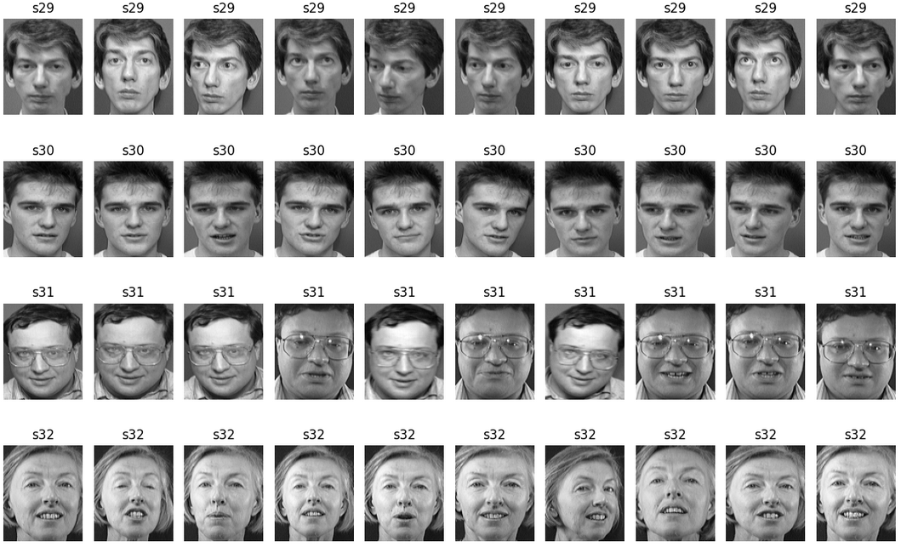
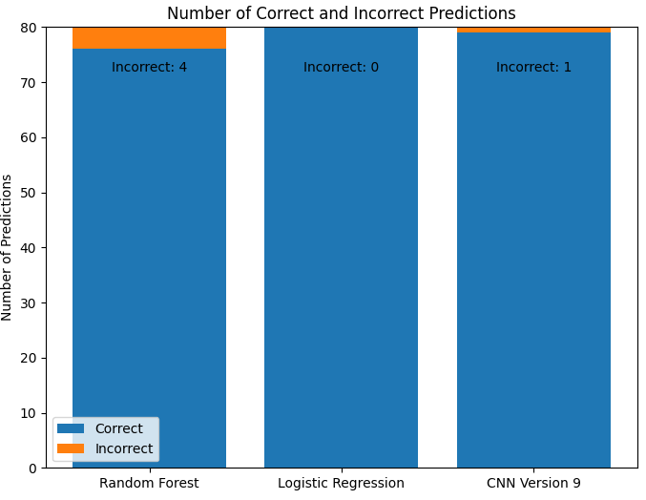
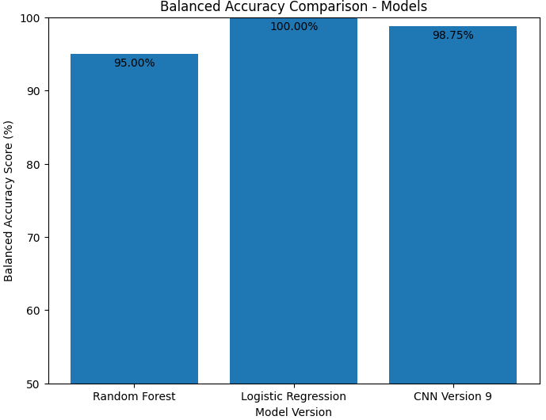
Comparisons Across Models
Notes:
Dominic: As you can see, Logistic Regression performed the best of all three models. While Random Forest model achieved a lower accuracy of 95% accuracy, it is worth noting that this was achieved with the greatest of ease and was computationally cheap compared to the two other models. Additionally, we didn’t employ any fine tuning. Although the CNN model achieved an accuracy of 98.75%, architecture required multiple versions of exploration before achieving this level of performance. It's also worth noting that while CNN models are specifically designed for image-related tasks, our dataset of 400 images may have limited the model's ability to learn complex patterns, leading to slightly lower accuracy. Now, let's briefly touch upon an intriguing avenue for further investigation that we encountered during our project.

Slide 10
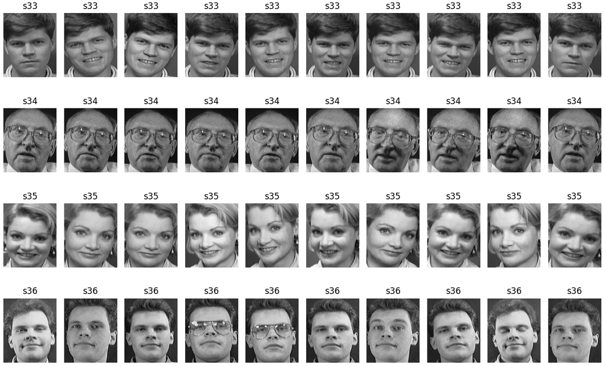
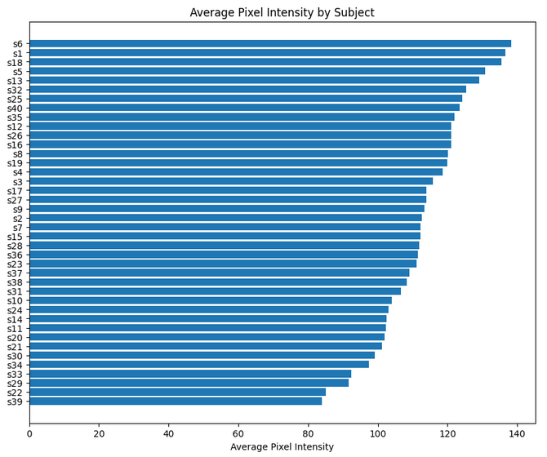
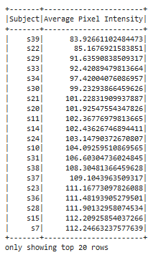
Average Pixel Intensity and PySpark
Notes:
Dominic: Based on an early hypothesis that there could be a correlation between misclassification and pixel intensity, the average pixel intensity for each subject's set of 10 images was calculated. A correlation was not found after visual inspection during the building of the models, so this was not further pursued. However, the calculations were loaded into PySpark (primarily to satisfy part of the grading rubric for this project) and it is possible that with the loading of additional DataFrames some relevant information could be retrieved for further exploration.

Slide 11
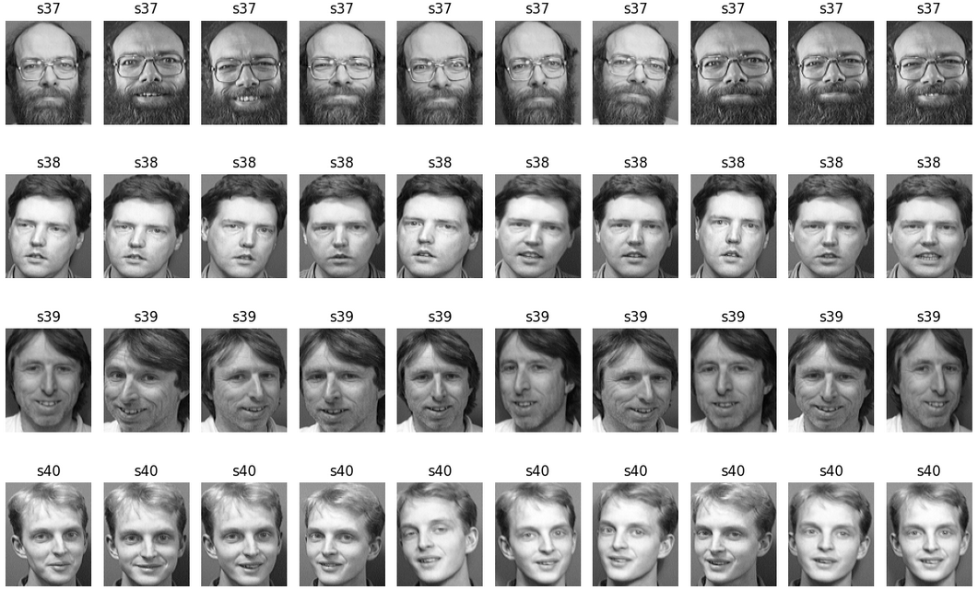
References
Using Random Forests for Face Recognition
The above link contains an excerpt from the book Machine Learning for OpenCV by Michael Beyeler. While the Random Forest Classifier model in the script referenced in this ReadMe does not utilize CV, using Random Forest for this solution was inspired by the link.
What is MNIST? And why is it important? On medium.com
The initial CNN model in this script pulls directly from the code and walkthrough in this Medium article, though the initial accuracy was very low (2.5%) prior to optimization.
Notes:
Dominic: Applying machine learning and deep learning for facial recognition required a lot of google searches, Chat GPT assists, but these two sources had a big impact on the development of this project. Using Random Forest for images was a new concept to explore, so a special thanks to the excerpt from Michael Beyeler’s book. And a HUGE shout out to the medium.com article on applying a CNN model to MNIST, which provided a starting point for getting the CNN model set up in this project.

Slide 12
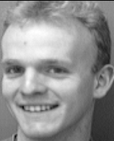
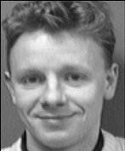


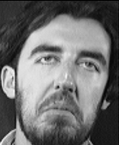
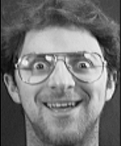

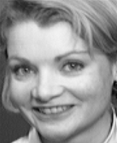
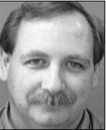
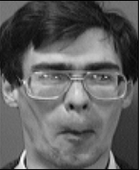
Questions?
Test Yourself
A. B. C. D. E.
F. G. H. I. J.
Notes:
Dominic: Thank you all for your attention. While we take questions, test your own recognition. You were shown a set of 10 pictures of a person at the beginning. Let us know which picture matches up with the set you were trained on by sending in your answer in the Slack #live channel.

Slide 13
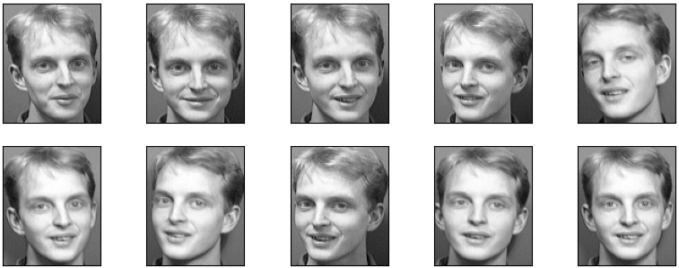
Thanks Everyone!
D.
Notes:
The answer was D!

